Slide 1
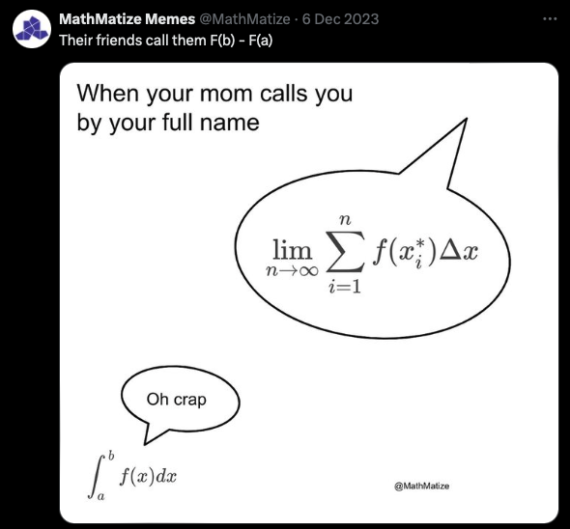
Computer Graphics: Rendering
Lecture 12: Monte Carlo Integration
Kartic Subr

Slide 2

Recap

Slide 3
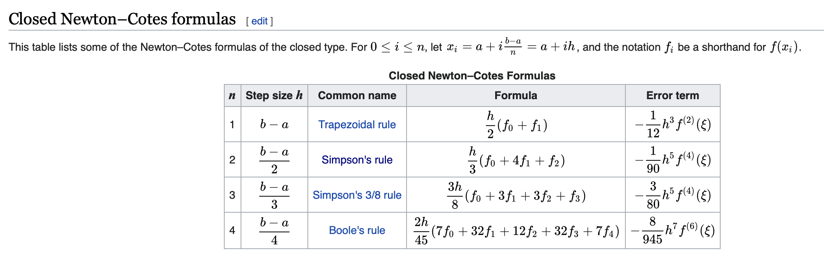

Newton-Cotes formulae
https://en.wikipedia.org/wiki/Newton–Cotes_formulas

Slide 4
Using randomness
Georges-Louis Leclerc, Comte de Buffon
(1707-1788)

Slide 5
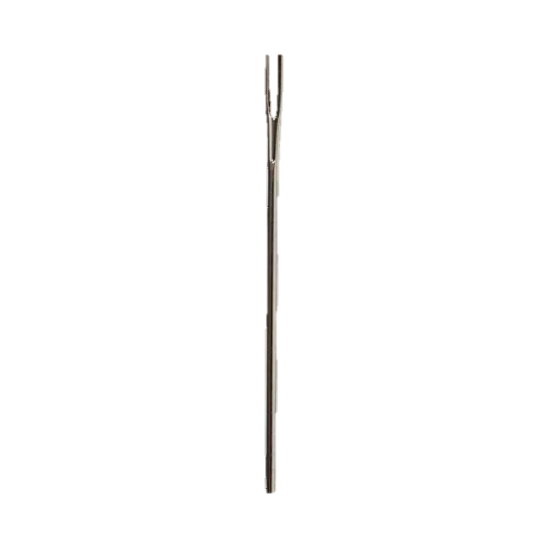

Using randomness
Suppose we have a floor made of parallel strips of wood, each the same width, and we drop a needle onto the floor. What is the probability that the needle will lie across a line between two strips?
t
$ℓ$< t
Georges-Louis Leclerc, Comte de Buffon
(1707-1788)

Slide 6
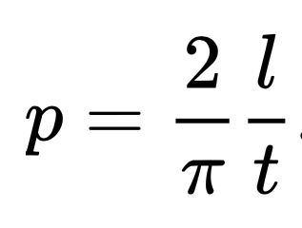
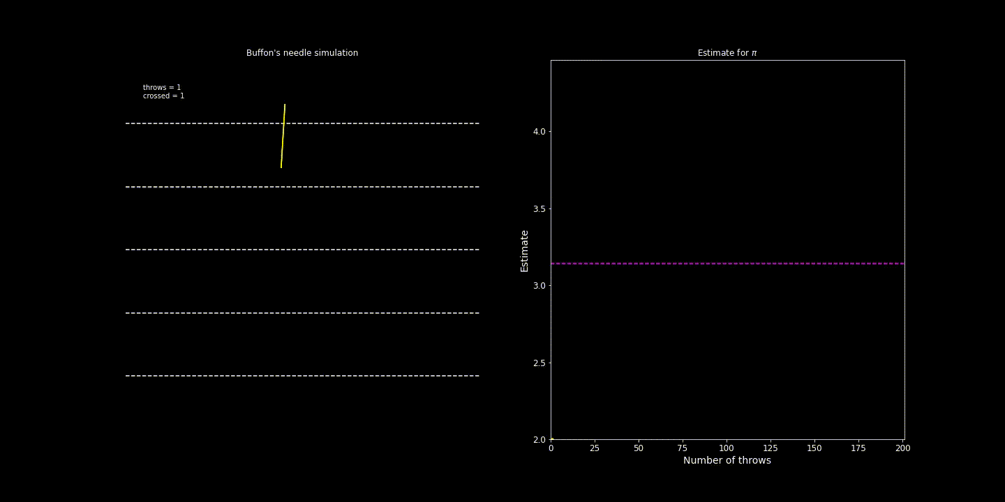
Using randomness
https://people.orie.cornell.edu/sbanerjee/courses/orie4580f20/
http://dmcpress.org/cm/buffon/experiment.html

Slide 7
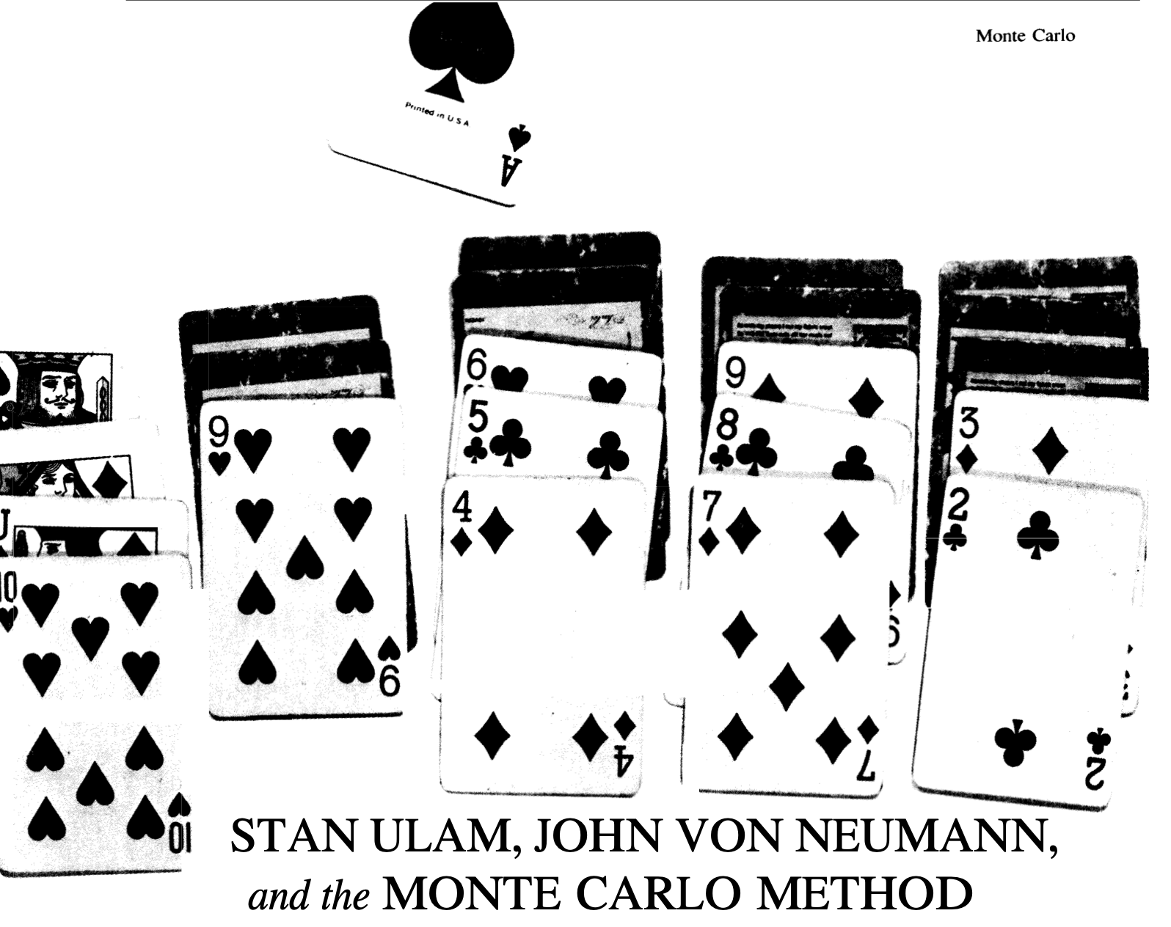
Monte Carlo method
http://www-star.st-and.ac.uk/~kw25/teaching/mcrt/MC_history_3.pdf

Slide 8

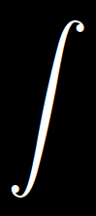

Why all the fuss?
Shiny ball in motion
Shiny ball, out of focus
…
pixel
multi-dim integral

Slide 9

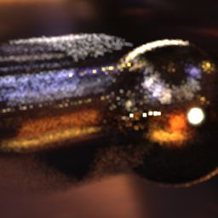

Estimating integrals, at the core of rendering!
Shiny ball, out of focus
…
pixel
multi-dim integral
Fixed steps in time
Random samples in time

Slide 10

Random variables: refresher

Slide 11


Continuous 1D distribution

Slide 12


Expectation, probability distribution, probability

Slide 13

Numerical integration using random samples

Slide 14
Numerical integration using random samples

Slide 15
Area of a circle

Slide 16
From integrating circles to general functions

Slide 17
Formally …

Slide 18
Importance sampling: intuition

Slide 19
Importance sampling: intuition

